Slide 1
Rescue Robot Design
By Robohood

Slide 2
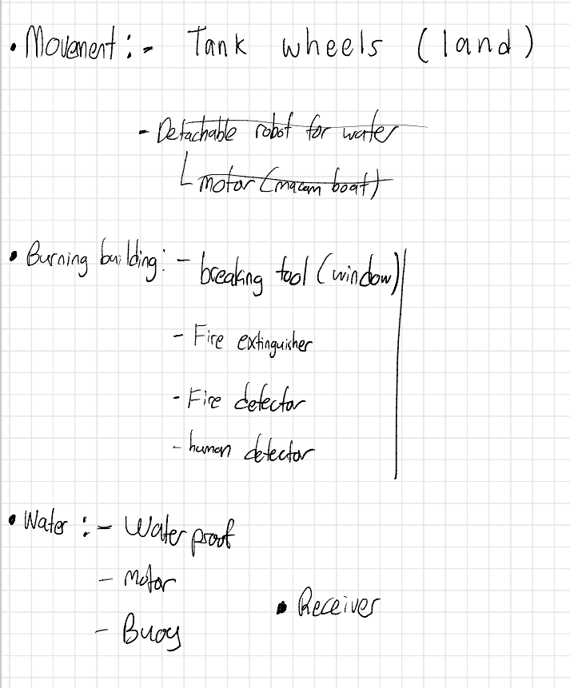
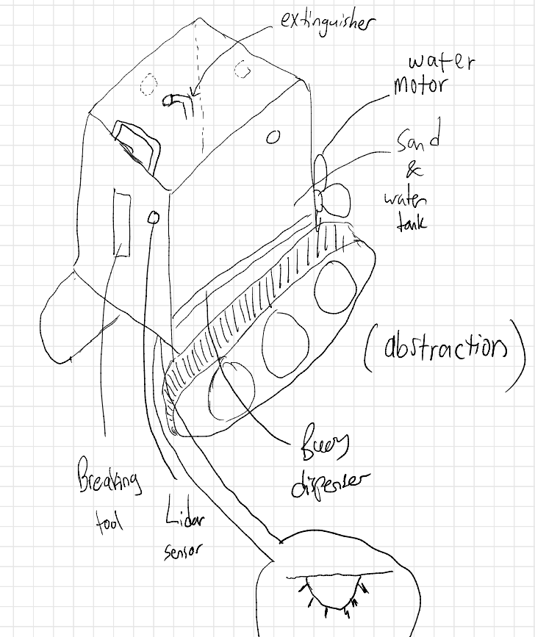
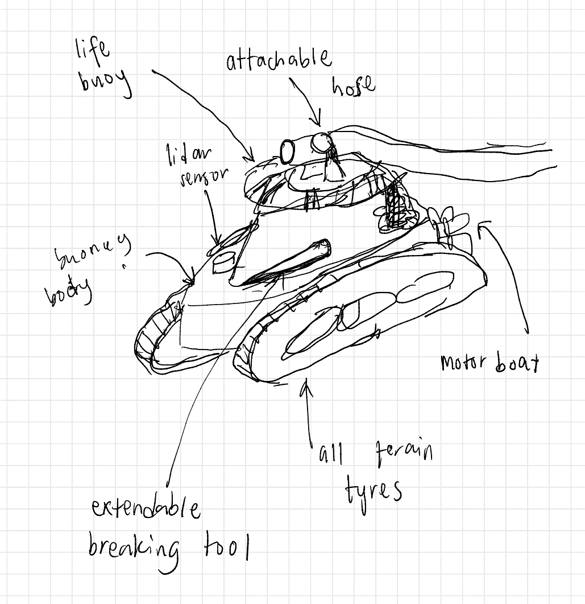
Design Idea

Slide 3
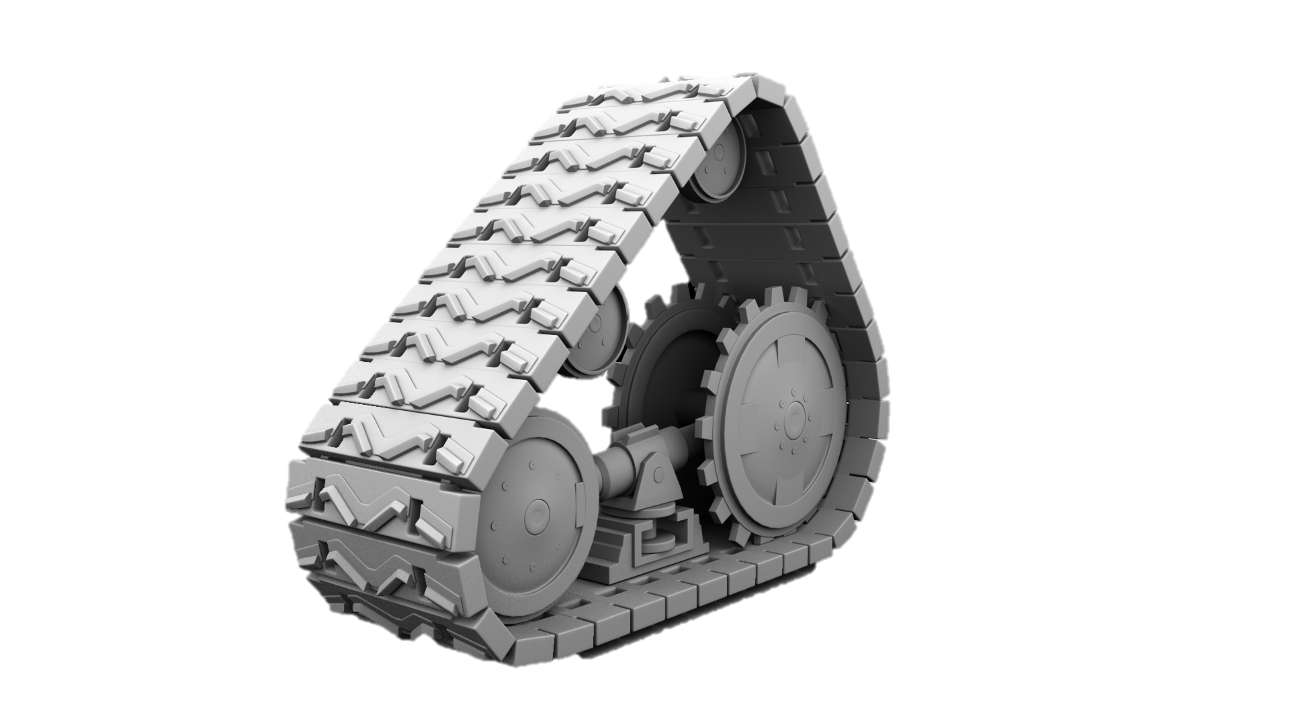
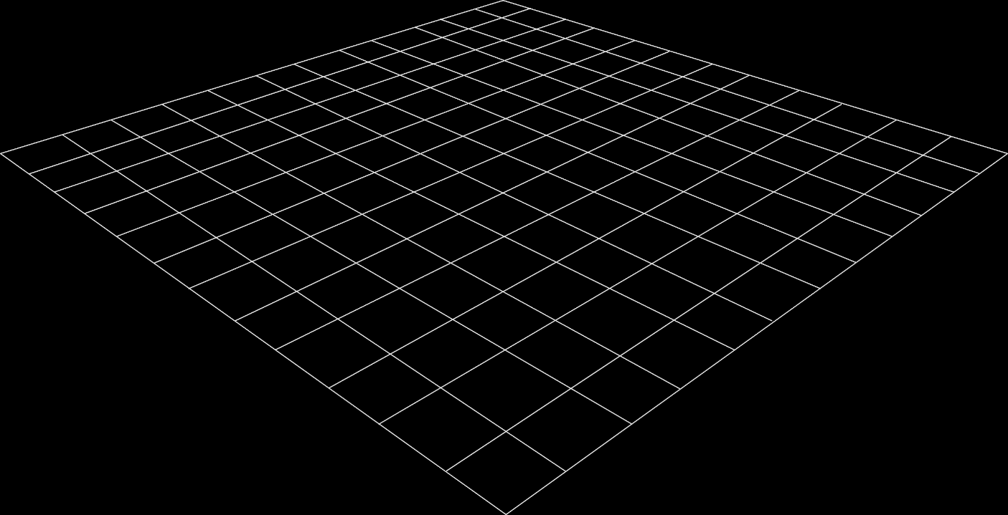

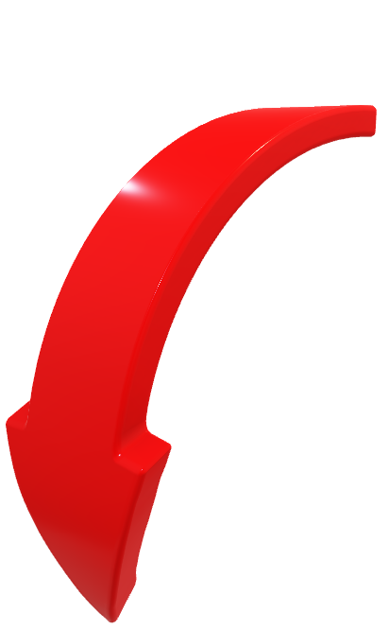
Move System on land – rotating continuous track
Advantages
Disadvantages
Can move on rough surface and going up stair
Slower speed due to more friction
The robot will have more component that build up the moving system
https://gocarrillo.artstation.com/projects/0gELw
Description Not only the track can move, the tringle of continuous track also can be rotated

Slide 4
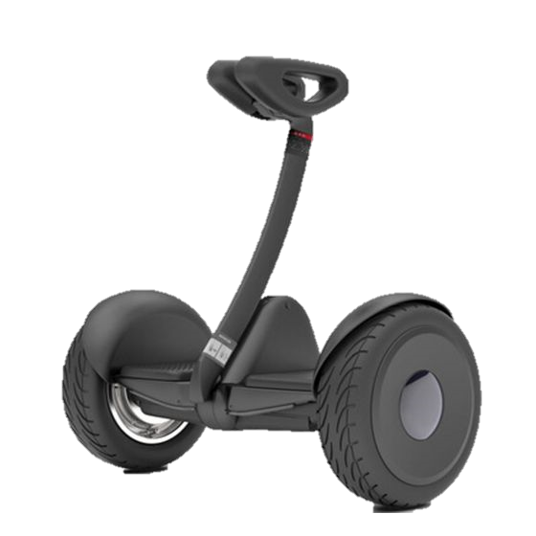
Move System on land – wheeled
Advantages
Disadvantages
In terms of energy efficiency on flat surfaces, wheeled robots are the most efficient.
Low cost
Simpler to design
Can be controlled easily
Wheeled robots are faster
It is difficult to move on uneven or rocky surface
https://www.aboutwaves.de/segway-ninebot-s.html
Description Only consist of two tires

Slide 5
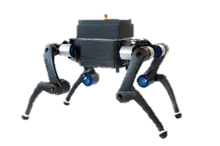
Move System on land – Walking/legged
Advantages
Disadvantages
makes it possible to negotiate uneven surfaces, steps, and other areas.
causes less damage to environmental terrain.
suffer an impact with the ground at heel strike and lose energy as a result
their locomotion methods are more complicated therefore complex to design
https://asl.ethz.ch/research/legged-robots.html
Description the robot have four legs

Slide 6
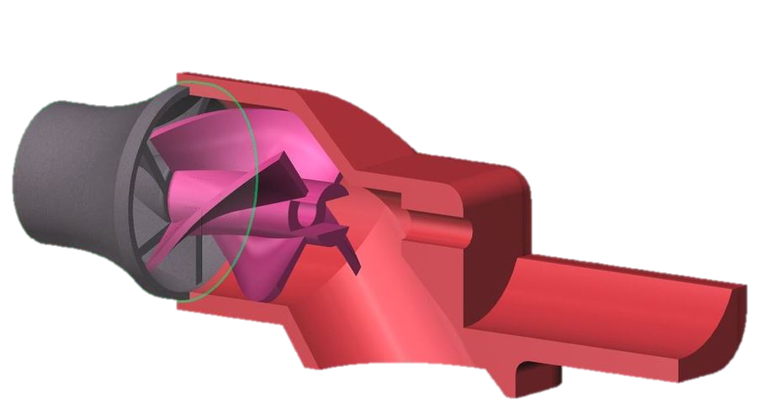
Move System on water – Jet Drive
Advantages
Disadvantages
certainly, quicker to accelerate.
Safer in conditions where impacts with foreign objects specially in water
sluggish and difficult to control
https://pinshape.com/items/6126-3d-printed-water-jet-drive
Description water are compressed and fired to the opposite direction of robot’s movement

Slide 7
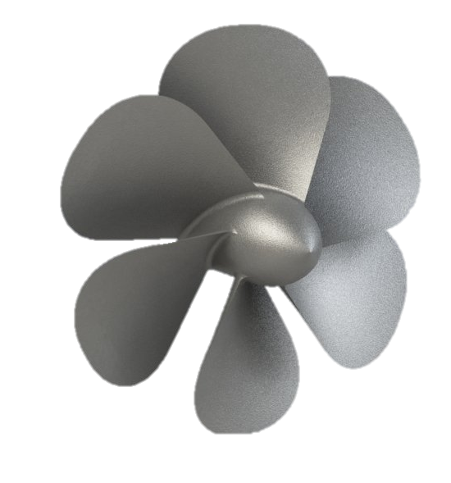
Move System on water – Sterndrive
Advantages
Disadvantages
efficient power transfer from the engine to the water.
hazard to swimmers behind the boat.
heavier than a jet engine
susceptible to damage if they impact the bottom or an obstruction in the water, like a rock or tree stump lurking just below the surface.
https://3dexport.com/free-3dmodel-propeller-279705.htm
Description located inside the boat with a steerable outdrive

Slide 8
That’s all
Thank you

